Slide 1
Milestone 3
Hoyoung Kim

Slide 2
Introduction
Amazon Web service is a site that major corporate rely on for cloud computing.
Major business that rely on amazons are Airbnb, Netflix, McDonalds, Twitch, Pfizer, Twitter and over 7,500 government facilities

Slide 3
AWS Security
AWS uses MFA, Access keys and IAM for reliable security
Majority pitfalls lie in IAM where permission boundaries are set
IAM is, over all, it’s a effective way for business to be able to manage security

Slide 4
Security Perspective
Compliance: Aligning IAM with regulatory standards like GDPR(General Data Protection Regulation), HIPAA, PCI DSS(Payment Card Industry Data Security Standard).
Business: Balancing security needs with operational needs efficiency. And ensures access requests are handled effectivly

Slide 5
Pitfall in AWS IAM security
Although MFA and access keys secure outsiders from accessing, Misconfiguration can have dire effect on security
IAM although may secure access, other parts of AWS also needs to be configured to secure all information
US DOD has leaked major battlefield intelligence information's due to misconfigured S3 buckets.

Slide 6
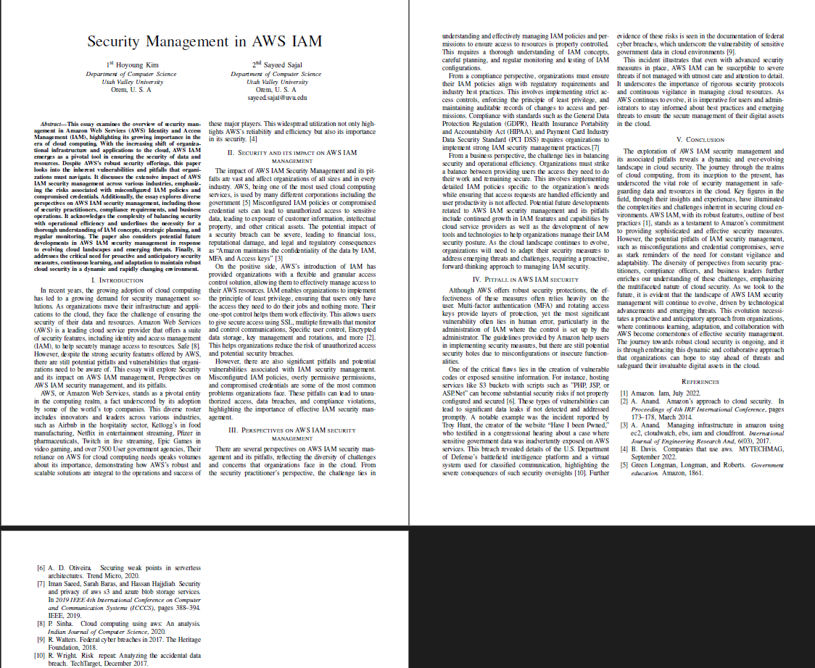
references
[1] Amazon. Iam, July 2022.
[2] A. Anand. Amazon’s approach to cloud security. In
Proceedings of 4th IRF International Conference, pages
173–178, March 2014.
[3] A. Anand. Managing infrastructure in amazon using
ec2, cloudwatch, ebs, iam and cloudfront. International
Journal of Engineering Research And, 6(03), 2017.
[4] B. Davis. Companies that use aws. MYTECHMAG,
September 2022.
[5] Green Longman, Longman, and Roberts. Government
education. Amazon, 1861.
[6] A. D. Oliveira. Securing weak points in serverless
architectures. Trend Micro, 2020.
[7] Iman Saeed, Sarah Baras, and Hassan Hajjdiab. Security
and privacy of aws s3 and azure blob storage services.
In 2019 IEEE 4th International Conference on Computer
and Communication Systems (ICCCS), pages 388–394.
IEEE, 2019.
[8] P. Sinha. Cloud computing using aws: An analysis.
Indian Journal of Computer Science, 2020.
[9] R. Walters. Federal cyber breaches in 2017. The Heritage
Foundation, 2018.
[10] R. Wright. Risk repeat: Analyzing the accidental data
breach. TechTarget, December 2017.

